Slide 1
Building Heat Load Analysis
UPV-EHU, Bilbao, 2022-01-10/13

Slide 2
Introduction
Learning outcomes
Index
Tools & data

Slide 3
Learning outcomes
Energy & Cost
Understand the dynamics of energy loads in buildings
Understand hoy energy loads are converted into cost
Review variability sources in the energy loads & tariffs
Measurement & Verification
Understand the Measurement & Verification Concept
Review meter technology and data capture processes
Deliver assessment models
Modern Data Platforms & Analysis Techniques
Understand the potentialities of modern data platform to deliver more detailed models
Review data analysis methods

Slide 4
Index
Day 1, Heat Loads in buildings
Heat loads in buildings
Heating & Cooling Cycles
DHW Cycles
Day 2, Measurement & verification
Measurement & Verification
Meters
EXERCISE
Day 3, Variability of Loads & Energy Carriers
Price of energy carriers
Variability
Data Quality
Day 4, Energy Management Platforms & Advanced Analysis Methods
Energy management platforms
Analysis methods
Revision of analysis methods
Wrap-up & Bonus materials

Slide 5
Tools & Data
Data for one building in Tartu
Heating load, hourly
Climate, hourly
Calendar & Bank Holidays
MS-EXCEL
Enough for this seminar. But not for daily life.
Students are strongly advised to pick & master one programming tool. Python, R,…

Slide 6
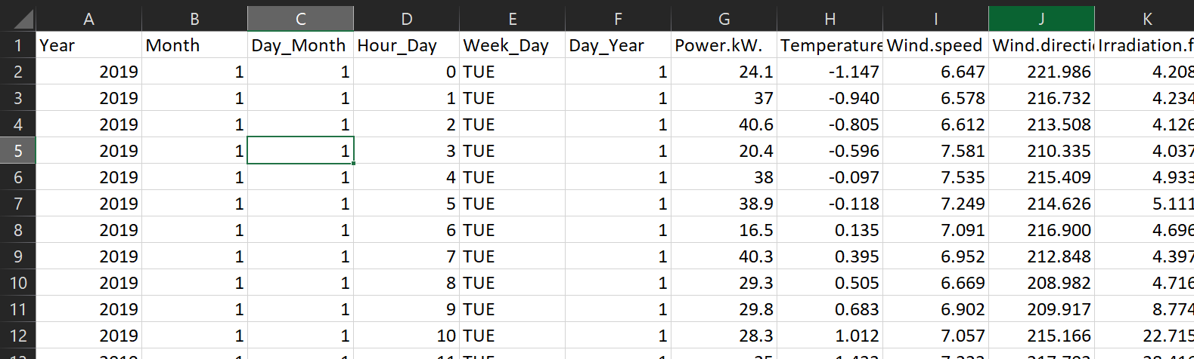
Tools & Data
Data of one building in Tartu
Heating load, hourly
Climate, hourly
Calendar & Bank Holidays
Calendar
Load
KW
or
KWh
Climate
ºC W/m2
Hourly data
Should be 8760h
But there is some data loss

Slide 7
Heat loads in buildings
Energy balance Heating & Cooling
Relation to climate

Slide 8

Energy balance Heating & Cooling
HEAT GAIN
HEAT LOSS
Roof
People, appliances
Sun
Walls
Windows
Heating Systems
Ventilation
Heat utilization factor
Heat losses,…
Basement
Domestic Hot Water
Domestic Hot Water
LESOSAI 5. Mode de Emploi. 2002.
https://docplayer.fr/57528916-Lesosai-5-calcul-du-bilan-thermique-d-une-construction-sia-380-1-en832-et-minergie.html

Slide 9
Relation to climate
Heating & Cooling loads are correlated with outdoor temperatura
Cold Weather | High Heating Loads & Low Cooling loads
Hot Weather | Low Heating Loads & High Cooling loads
Large Solar Irradiation | Low(er) Heating Loads & High(er) Cooling loads
Greater Wind Speed | Variable impact ~High(er) Heating Loads & ~Low(er) Cooling loads

Slide 10
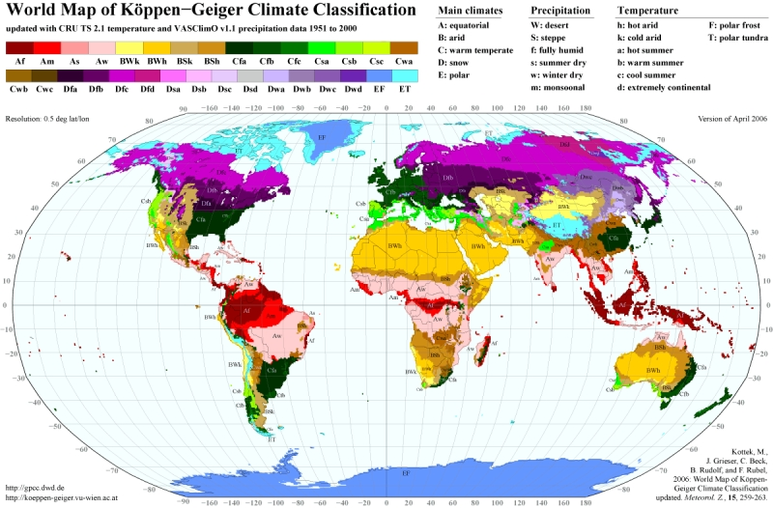
Kottek, M., J. Grieser, C. Beck, B. Rudolf, and F. Rubel, 2006: World Map of the Köppen-Geiger climate classification updated. Meteorol. Z., 15, 259-263.
DOI: 10.1127/0941-2948/2006/0130.

Slide 11
Relation to climate
Degree-Day Methods compute negative/positive deviations of daily mean ambient temperatures vs a reference temperature
Reference temperatures (typical)
Heating Degree Days: 15ºC
Cooling Degree Days: 23ºC
Reference temperatures are building dependent
NZEB. HDD temp. ~10-12ºC
Glazed building. HDD temp. ~20ºC

Slide 12
Relation to climate
Reference Temperature, Heating [ºC]
Reference Temperature, Cooling [ºC]
Daily Mean Temperature [ºC]
Too cold to be confortable without heating
Too hot to be confortable without cooling

Slide 13
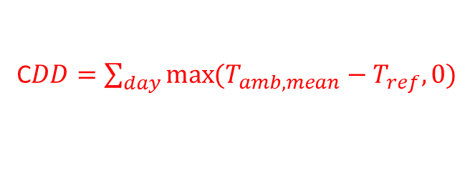
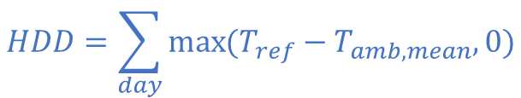
Relation to climate
$$HDD=\sum_{day}{\max{(T_{ref}−T_{amb,mean},0)}}$$
C$DD=\sum_{day}{\max{(T_{amb,mean}−T_{ref},0)}}$
Daily Mean Temperature [ºC]

Slide 14
Relation to climate

Slide 15
Relation to climate

Slide 16


HDD (15ºC)
HDD (20ºC)
CDD (20ºC)
IDAE. Guía técnica Condiciones climáticas exteriores de proyecto. 2010
https://www.idae.es/uploads/documentos/documentos_12_Guia_tecnica_condiciones_climaticas_exteriores_de_proyecto_e4e5b769.pdf

Slide 17

https://www.degreedays.net/

Slide 18
Heat loads in buildings (summary)
Energy balance Heating & Cooling
Buildings need to balance heat gain and loss to ensure a comfortable environment
Heat is injected by means of heating appliances (e.g. boilers)
Heat is removed by means of cooling appliances (e.g. air conditioning)
Relation to climate
Various climates across the globe
Temperature is the main index to define climate severity
Loads can be indexed to mean outdoor temperature
Heating/Cooling Degree Days are a common climate severity indicator
Heating & Cooling loads are time/season dependent

Slide 19
Heating & Cooling Cycles
Day-night
Thermostat cycles
Occupation
Week
Season
De-activation in summer
Criteria for re-activation
Holidays

Slide 20
Day-Night Cycles
Buildings are used unsteadily
Residential buildings. Mainly at night
Office & service buildings. ~8-17h
Some exceptions: Hospitals, Data centres, Airports,…
But even in these cases, there are specific patterns (sect. 7)
Heating is activated to meet occupant confort
According to the aforementioned cycles
Some technical adaptations
Initiated before the actual occupation to ensure confort levels
Deactivated slightly earlier than end of occupation to sabe Energy
Background temperature levels are defined to avoid extreme low conditions.

Slide 21
Weekly Cycles
Buildings are used unsteadily
Residential buildings. Change patterns on weekends & holidays
Office & service buildings. Commonly closed on weekends & holidays
Some exceptions: Hospitals, Data centres, Airports,…
But even in these cases, there are specific patterns (sect. 7)
Heating is activated to meet occupant confort
According to the aforementioned cycles
Some technical adaptations
Shutdown
Adaptation of actuation periods
Manual/Automatic thermostats & operation of valves
Background temperature levels are defined to avoid extreme low conditions

Slide 22
Seasonal Cycles
Heating loads are higher in Winter & intermediate periods
There is a certain point in Spring where heating is no longer needed
DE-ACTIVATION METHODs
Calendar. Performed manually by service crews
e.g. 31st April (Spain).
Climate. Implemented in control system
e.g. 15 consecutive days with HDD=0
e.g. 15 consecutive days with daily mean T>15ºC
…
(also performed manually by service crews*)
Continously ON for specific buildings (Hospitals, Techical systems,…)

Slide 23
Seasonal Cycles
There is a certain point in Autumn where heating is required again
ACTIVATION METHODs
Calendar. Performed manually by service crews
e.g. 15th October (Spain).
Climate. Implemented in control system
e.g. 7 consecutive days with HDD>0
e.g. 7 consecutive days with daily mean T<12ºC
…
(also performed manually by service crews*)
(when user calls the service manager*)

Slide 24

Example
Sicheng Zhan, Zhaoru Liu, Adrian Chong, Da Yan, Building categorization revisited: A clustering-based approach to using smart meter data for building energy benchmarking, Applied Energy, Volume 269, 2020, https://doi.org/10.1016/j.apenergy.2020.114920
Freely available at https://ideaslab.io/publication/zhan-2020-building/
WARNING﻿: Magnitudes are normalized to daily maximum values.
Daily MAX = 1

Slide 25
Example
Daily (electricity) profiles
Sicheng Zhan, Zhaoru Liu, Adrian Chong, Da Yan, Building categorization revisited: A clustering-based approach to using smart meter data for building energy benchmarking, Applied Energy, Volume 269, 2020, https://doi.org/10.1016/j.apenergy.2020.114920
FIGURE 5

Slide 26
Example
Daily (electricity) profiles
Sicheng Zhan, Zhaoru Liu, Adrian Chong, Da Yan, Building categorization revisited: A clustering-based approach to using smart meter data for building energy benchmarking, Applied Energy, Volume 269, 2020, https://doi.org/10.1016/j.apenergy.2020.114920
FIGURE 4

Slide 27
Example
Daily (electricity) profiles
Different occupation period lengths:
Short working day
Longer working day
Extended afternoon periods
Sicheng Zhan, Zhaoru Liu, Adrian Chong, Da Yan, Building categorization revisited: A clustering-based approach to using smart meter data for building energy benchmarking, Applied Energy, Volume 269, 2020, https://doi.org/10.1016/j.apenergy.2020.114920
FIGURE 4

Slide 28
Example
Daily (electricity) profiles
Sicheng Zhan, Zhaoru Liu, Adrian Chong, Da Yan, Building categorization revisited: A clustering-based approach to using smart meter data for building energy benchmarking, Applied Energy, Volume 269, 2020, https://doi.org/10.1016/j.apenergy.2020.114920
FIGURE 4
Different occupation period lengths:
Low afternoon activity
High afternoon activity

Slide 29
Example
Weekends
Vacation periods
Bank holidays
Calendar
Sicheng Zhan, Zhaoru Liu, Adrian Chong, Da Yan, Building categorization revisited: A clustering-based approach to using smart meter data for building energy benchmarking, Applied Energy, Volume 269, 2020, https://doi.org/10.1016/j.apenergy.2020.114920
FIGURE 8

Slide 30
Example
Share of profiles
(mostly) Residential
(mostly) Office
Morning
Morning+Afternoon
No predominance
Sicheng Zhan, Zhaoru Liu, Adrian Chong, Da Yan, Building categorization revisited: A clustering-based approach to using smart meter data for building energy benchmarking, Applied Energy, Volume 269, 2020, https://doi.org/10.1016/j.apenergy.2020.114920
FIGURE 13

Slide 31
Heating & Cooling Cycles (Summary)
There are typical cycles in a building
Day-night
Weekday-wekend
Season
Bank Holidays
Each building has unique occupation profiles based on their type of use, HVAC systems, operation criteria,…

Slide 32
DHW Cycles
Domestic Hot Water Preparation
Basic Engineering Formulation
Daily profile
Changes in cold water temperature. Impact on load
Holidays

Slide 33
Domestic Hot Water preparation
~ Stable heat load (+-20%)
Calculations defined in building codes
Water Flow
Supply temperature
Source temperature defined by climate.
Stable ~8-18ºC
Variations occur during the day

Slide 34
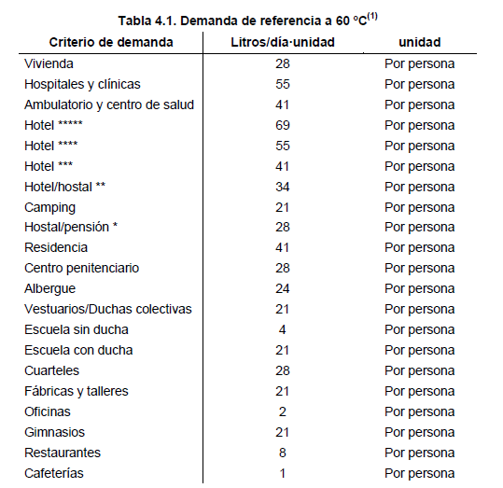
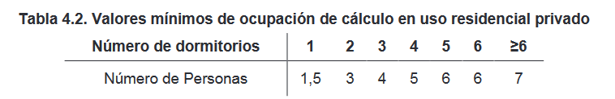
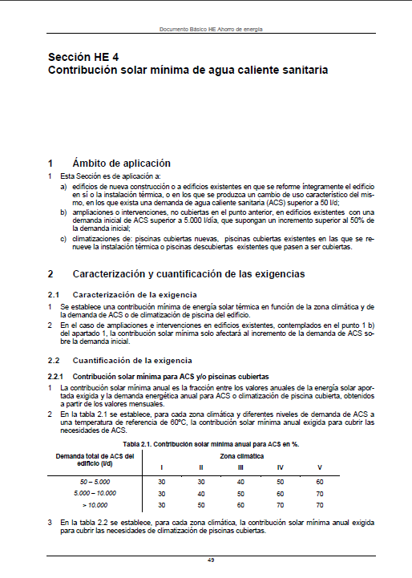
l/day-person
Dwellings
Hospital
Health centre
Minimum ocupancy in residential buildings for DHW calculation
Rooms
People
CTE Documento Básico HE 4. Contribución solar mínima de agua caliente sanitaria
https://www.codigotecnico.org/images/stories/pdf/ahorroEnergia/DBHE.pdf

Slide 35
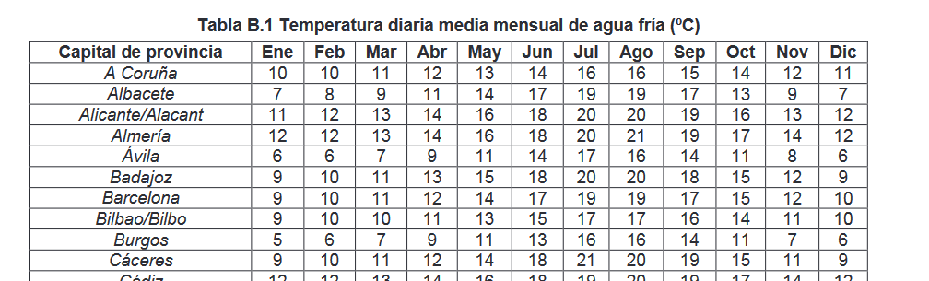
Basic Engineering Formulation
Q = m * Cp * (T_sup – T_netw)
m as defined in CTE HE4
Cp = 4,18 kJ / (l*K)
T_sup = 60 ºC
T_source as per local climate
Bilbao: 9-17ºC

Slide 36
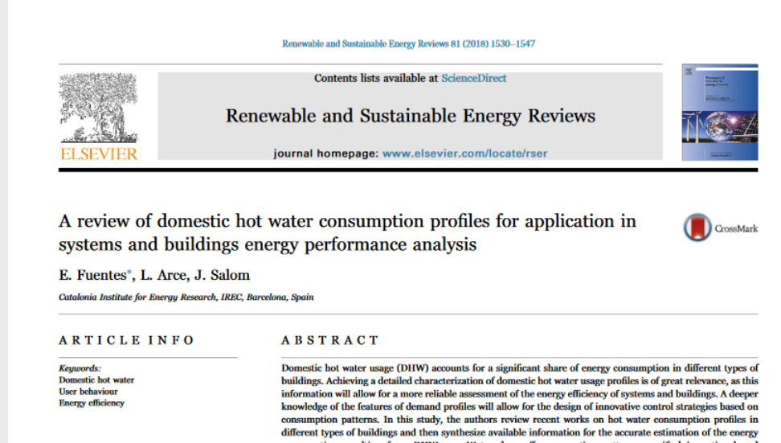
E. Fuentes, L. Arce, J. Salom, A review of domestic hot water consumption profiles for application in systems and buildings energy performance analysis,
Renewable and Sustainable Energy Reviews, Volume 81, Part 1, 2018, Pages 1530-1547, ISSN 1364-0321, https://doi.org/10.1016/j.rser.2017.05.229.

Slide 37
Daily Profile
E. Fuentes, L. Arce, J. Salom, A review of domestic hot water consumption profiles for application in systems and buildings energy performance analysis,
Renewable and Sustainable Energy Reviews, Volume 81, Part 1, 2018, Pages 1530-1547, ISSN 1364-0321, https://doi.org/10.1016/j.rser.2017.05.229.
FIGURE 4
E. Fuentes, L. Arce, J. Salom, A review of domestic hot water consumption profiles for application in systems and buildings energy performance analysis,
Renewable and Sustainable Energy Reviews, Volume 81, Part 1, 2018, Pages 1530-1547, ISSN 1364-0321, https://doi.org/10.1016/j.rser.2017.05.229.

Slide 38
Daily Profile
E. Fuentes, L. Arce, J. Salom, A review of domestic hot water consumption profiles for application in systems and buildings energy performance analysis,
Renewable and Sustainable Energy Reviews, Volume 81, Part 1, 2018, Pages 1530-1547, ISSN 1364-0321, https://doi.org/10.1016/j.rser.2017.05.229.
FIGURE 5
E. Fuentes, L. Arce, J. Salom, A review of domestic hot water consumption profiles for application in systems and buildings energy performance analysis,
Renewable and Sustainable Energy Reviews, Volume 81, Part 1, 2018, Pages 1530-1547, ISSN 1364-0321, https://doi.org/10.1016/j.rser.2017.05.229.

Slide 39
Holidays (months)
E. Fuentes, L. Arce, J. Salom, A review of domestic hot water consumption profiles for application in systems and buildings energy performance analysis,
Renewable and Sustainable Energy Reviews, Volume 81, Part 1, 2018, Pages 1530-1547, ISSN 1364-0321, https://doi.org/10.1016/j.rser.2017.05.229.
FIGURE 6
E. Fuentes, L. Arce, J. Salom, A review of domestic hot water consumption profiles for application in systems and buildings energy performance analysis,
Renewable and Sustainable Energy Reviews, Volume 81, Part 1, 2018, Pages 1530-1547, ISSN 1364-0321, https://doi.org/10.1016/j.rser.2017.05.229.

Slide 40
Holidays (weekdays)
E. Fuentes, L. Arce, J. Salom, A review of domestic hot water consumption profiles for application in systems and buildings energy performance analysis,
Renewable and Sustainable Energy Reviews, Volume 81, Part 1, 2018, Pages 1530-1547, ISSN 1364-0321, https://doi.org/10.1016/j.rser.2017.05.229.
FIGURE 8
E. Fuentes, L. Arce, J. Salom, A review of domestic hot water consumption profiles for application in systems and buildings energy performance analysis,
Renewable and Sustainable Energy Reviews, Volume 81, Part 1, 2018, Pages 1530-1547, ISSN 1364-0321, https://doi.org/10.1016/j.rser.2017.05.229.

Slide 41
Changes in cold water temperature. Impact on load
Bilbao: 9-17ºC
Flow Temperature: ~50ºC
Network Temperature: 9-17ºC
(assumption: constant consumption levels)
Max AT: ºC
Min AT: ºC
41
33
Variation: %
19,5
(41-33)/41 [%]

Slide 42
DHW Cycles (Summary)
~ (seasonally) Stable heat load (+-20%)
Heavy intra-daily variations
Loads vary depending on type of building
Dwellings: ~2 peak periods @early monring & late afternoon
Restaurants: ~peak periods @ lunch & dinner time
…

Slide 43
Measurement & Verification
What is M&V
Why is it important
Key references
Estimating energy savings
Key concepts
Scopes/Approaches

Slide 44
What is M&V
Define the performance of a system
Absolute terms (e.g. one building/plant/…)
Relative to a pre-existing baseline (e.g. building retrofit)
By means of measurement
Allowing for corrections
Climate +-10-15% per year
Variations in use calendar, work shifts, COVID-19
Variations in system configuration retrofits, malfunctions,…
Variations in cost of Energy +-5-30% depending on world-level market changes

Slide 45
Why is it important (I)
Cycle of an Energy System
Audit Oportunity is identified
Basic Engineering Investment & Performance are Estimated
Detailed Engineering Investment & Performance are Determined
Construction Cost is executed
Commissioning Performance is set
Operation Energy is delivered
Maintenance System performance is kept ~constant
Typically, different stakeholders are responsable of these ítems
Owner
Tenant
Engineering offices
Installer
(with associated cost)
- Financing body
- Maintenance company

Slide 46
Why is it important (II)
Cost and Performance Should be Accountable
Energy performance Contracts
Increasingly common
Get external financing
Guarantee performance of the actual system
Define payments based on actual performance
Performance
Guarantee ≠Design
≠Rated
≠Estimated
≠Max
≠Min
Definitions
Energy [MWh], [%],…
Currency [€/MWh], [max€],…

Slide 47
Key references
ASHRAE 14, “Measurement of Energy, Demand and Water Savings”
CIBSE TM22: 2006, “Energy assessment and reporting method”
Efficiency Valuation Organization (EVO), International Performance Measurement and Verification Protocol (IPMVP)
ISO 50001:2018, Energy management systems — Requirements with guidance for use
ISO 50002, Energy audits — Requirements with guidance for use
ISO 50006, Energy management systems — Measuring energy performance using energy baselines (EnB) and energy performance indicators (EnPI) — General principles and guidance
ISO 50047, Energy savings — Determination of energy savings in organizations
Etc.
US DOE, “M&V Guidelines: Measurement and Verification for Federal Energy Projects”

Slide 48
Estimating energy savings
Energy saving are avoided energy flows
They are not actual energy flows.
CAN NOT BE MEASURED
Savings are calculated as the difference two magnitudes
Energy consumed if no intervention was done (Baseline)
Actual consumption
These two items are measured in different time frames
Corrections are required for climate & other factors

Slide 49
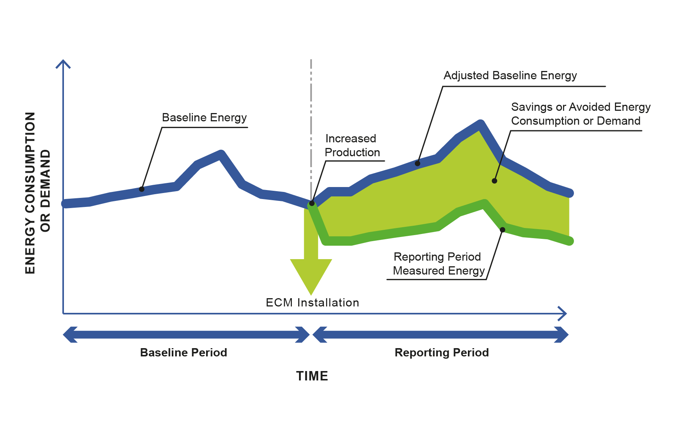
Pre-intervention data
Used to construct a model
BASELINE
Model is fed with post-intervention data
Post-intervention data
ACTUAL ENERGY USE

Slide 50
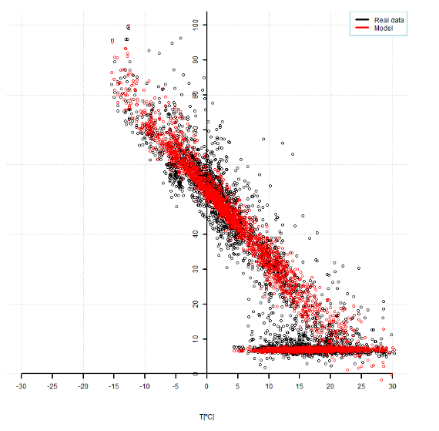
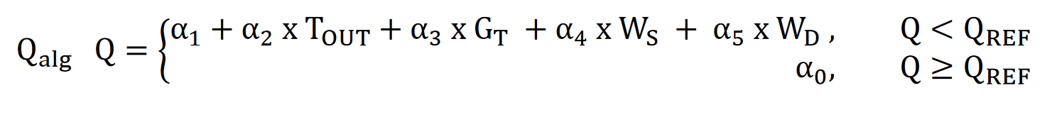
Mikel Lumbreras, Roberto Garay, Antonio Garrido Marijuan, Energy meters in District-Heating Substations for Heat Consumption Characterization and Prediction Using Machine-Learning Techniques,http://doi.org/10.1088/1755-1315/588/3/032007

Slide 51
Key concepts
(Excerpt from ISO 50001)
Significant energy use, SEU: [Process/Areas within a Buliding/Factory with…] substantial energy consumption and/or offering considerable potential for energy performance improvement
Boiler plant, chillers, thermal storage tanks, heat distribution y diffusion in buildings
Industrial processes
Transportation, fleets,… in some service companies
Police, waste management companies,…
Small office in Big Factory

Slide 52
Key concepts
(Excerpt from ISO 50001)
Measurement: process to determine a value
Meters & Counters
Signal/Data validation criteria & procedures
Agreed methods to determine performance/savings
Energy performance: Measurable result(s) related to:
Energy efficiency (η, COP, W/lumen…)
Energy use (kWh/m2.y, kWh/unit,…)
Energy consumption (kWh,…)
Energy performance indicator
Energy efficiency: … relationship between an output of performance, … and an input of energy (e.g. kWh/m2.y, kWh/unit)

Slide 53
Key concepts
(Excerpt from ISO 50001)
Energy baseline: Reference(s) providing a basis for comparison of energy performance
based on data from a specified period of time and/or conditions
Typically equations referring the performance (e.g. kWh) against relevant variables (e.g. HDD), calibrated against a period (e.g. September 2017-August 2019)
Static factor: Factor that significantly impacts energy performance and does not routinely change
e.g rented space in an office building
If (relevant) changes are identified, the models/equations are adjusted. Likeliness ~10-20% per year
Relevant variable: Factor that significantly impacts energy performance and routinely changes
E.g. weather, occupied rooms in a hotel, water consumption in a water treatment plant, amount of goods produced in a factory,…
Models/equations already comprise these variables, so that their output is adapted in every analysis cycle
Risk/ uncertainty

Slide 54
Scopes/Approaches
(IPMVP)
Typically 4 types of measurement/analysis scopes
Option A: Partially Measured ECM Isolation
Option B: ECM Isolation
Option C: Whole Building Comparison
Option D: Whole Building Calibrated Simulation

Slide 55
Scopes/Approaches
(IPMVP)
Option A: Partially Measured ECM Isolation
Analysis over only one subsystem
Simplified measurements
Option B: ECM Isolation
Analysis over only one subsystem
Complete measurements
Typical applications
Lighting
HVAC, change of 1 system
…

Slide 56
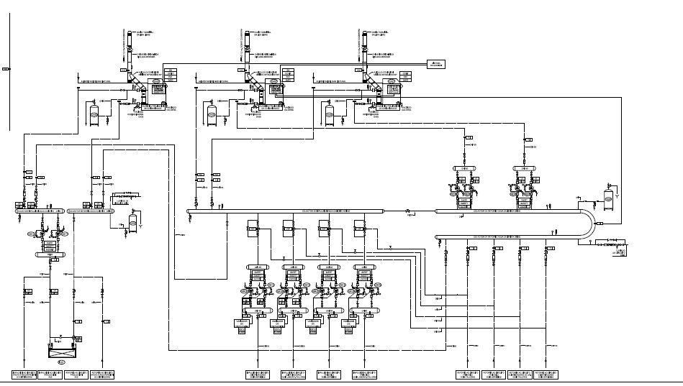
Scopes/Approaches
Replacement of one boiler in a larger building

Slide 57
Scopes/Approaches
(IPMVP)
Option C: Whole Building Comparison
Analysis over full building/systems
Full set of measurements
Typical applications
Several interlinked interventions
Renovation of windows, insulation of walls
Changes to control system
Changes to several HVAC appliances
…

Slide 58
Scopes/Approaches
Replacement of one boiler in a larger building
Change to control criteria of heat production
Variable Speed Drives
Changes to the building

Slide 59
Scopes/Approaches
(IPMVP)
Option D: Whole Building Calibrated Simulation
System does not exist before construction
Simulation model. Calibrated against measurement data

Slide 60
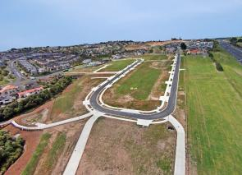
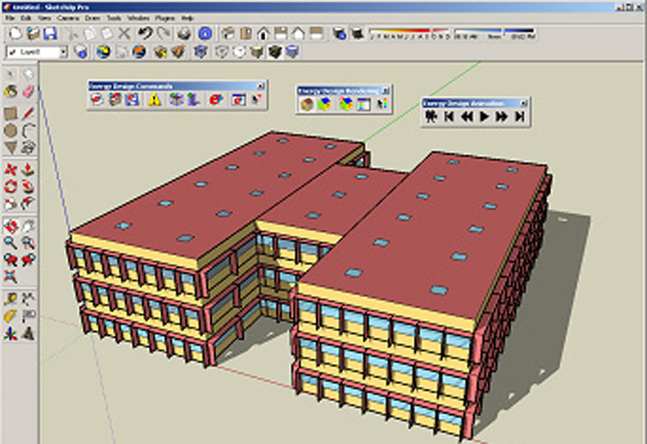
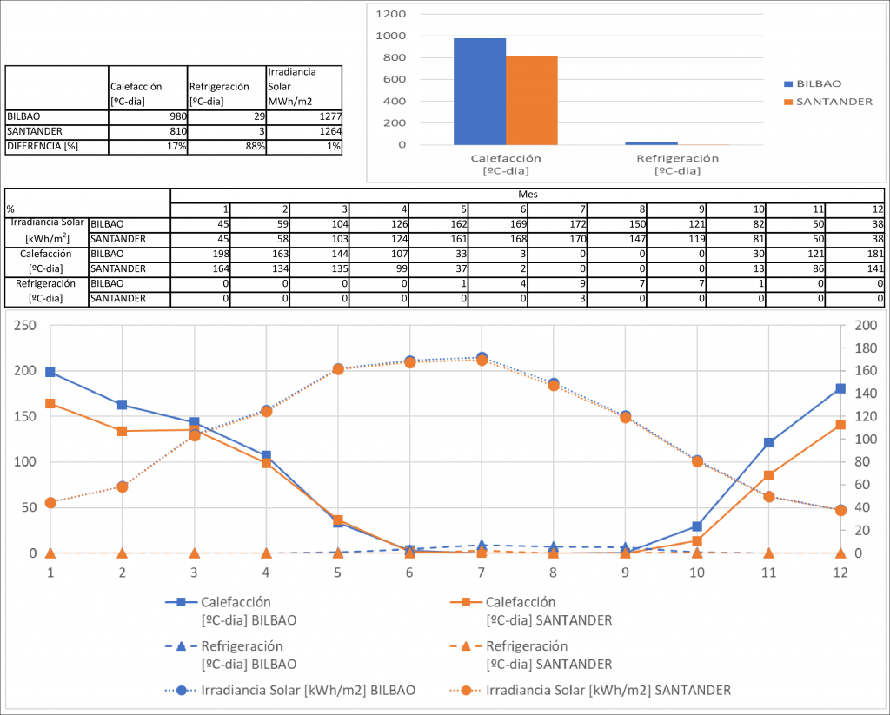
Scopes/Approaches
No pre-existing status.
Can not be measured
Build a model
Calibrate aganist
Post-construction data
Perform changes to the model
& assess baseline (blue line)

Slide 61
Measurement & Verification (Summary)
Measurement of the performance of a system
Improvements vs a baseline
Allowing for corrections due to climate & use factors
Uses
Performance-based contracts
Corporate Energy Management Policies
Methods
Some base methodologies
Various scopes
Adapted on a case-by-case basis (agreement between stakeholders)

Slide 62
Meters
Electricity
Natural Gas
Heat
Fuels

Slide 63
Electricity Meters
Smart meters deployed in EU.
Instantaneous metering available
In practical applications:
Network stability ~1minute
Large consummers ~10-15minute
Regular applications ~1h

Slide 64
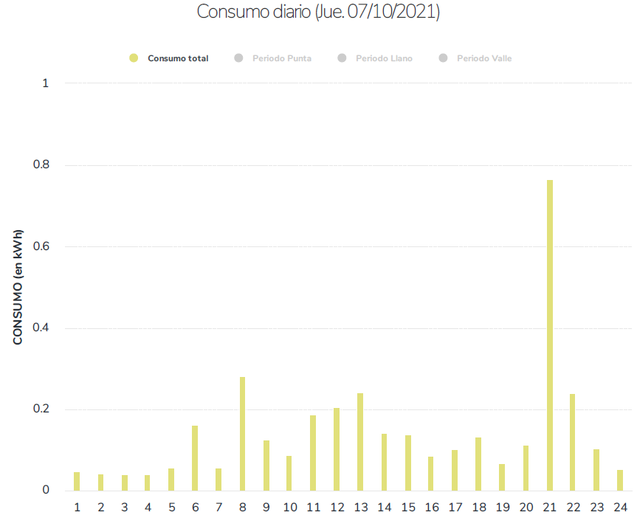
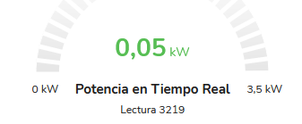
Hourly consumption of a private household.
Ibformation available from Distribution Company.

Slide 65
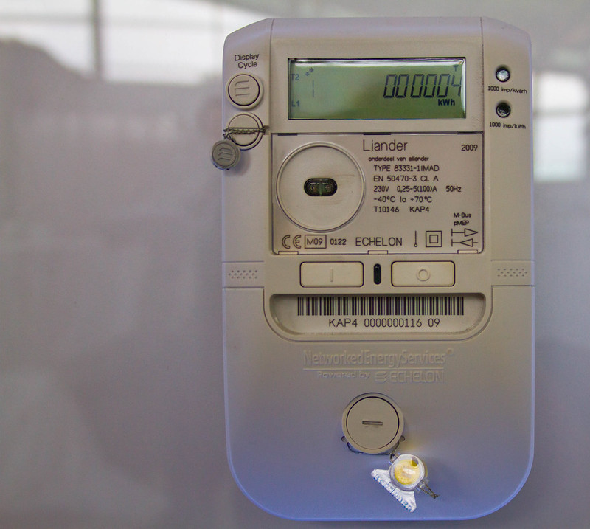
https://www.flickr.com/photos/traftery/4493063693
https://creativecommons.org/licenses/by-nc-sa/2.0/

Slide 66
Natural Gas Meters
Smart meters not yet deployed.
(Very) large industries: Daily values
Others: monthly aggregated data
Device measures the delivered volumen: Nm3
Density & specific heat is tabulated per city, day & pressure level

Slide 67
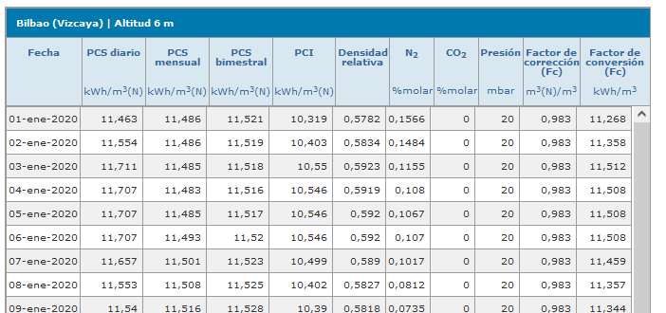
Natural Gas Meters
https://www.enagas.es/enagas/es/Gestion_Tecnica_Sistema/CalidadGas/CalidadGasMunicipio
kWh/m3
~+- 1%

Slide 68
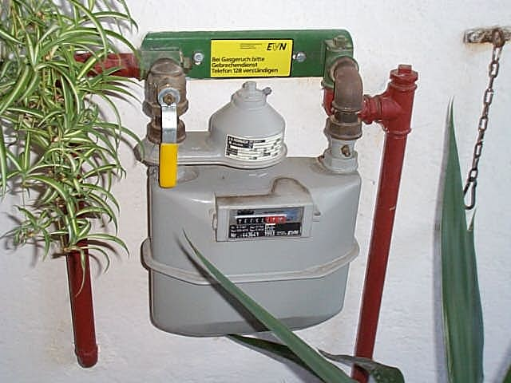
Natural Gas Meters
https://commons.wikimedia.org/wiki/File:Gas_meter.jpg Creative Commons Attribution-Share Alike 2.0 Austria

Slide 69
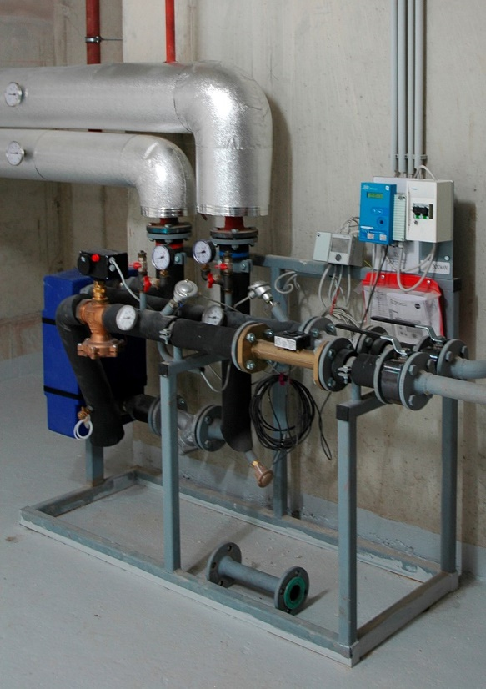
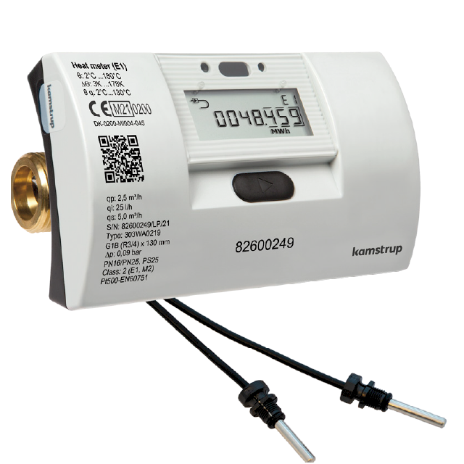
Heat Meters
Devices that measure the heat delivered by an hydraulic heating/cooling system
https://www.kamstrup.com/en-en/heat-solutions/heat-meters/multical-303
A heat meter attached to a heat exchanger in a District heating substation in a residential neighborhood. Right in white-blue: the calculator; in the center in bronze: the ultrasonic flow meter, © Ulrichulrich CC BY-SA 3.0. link

Slide 70
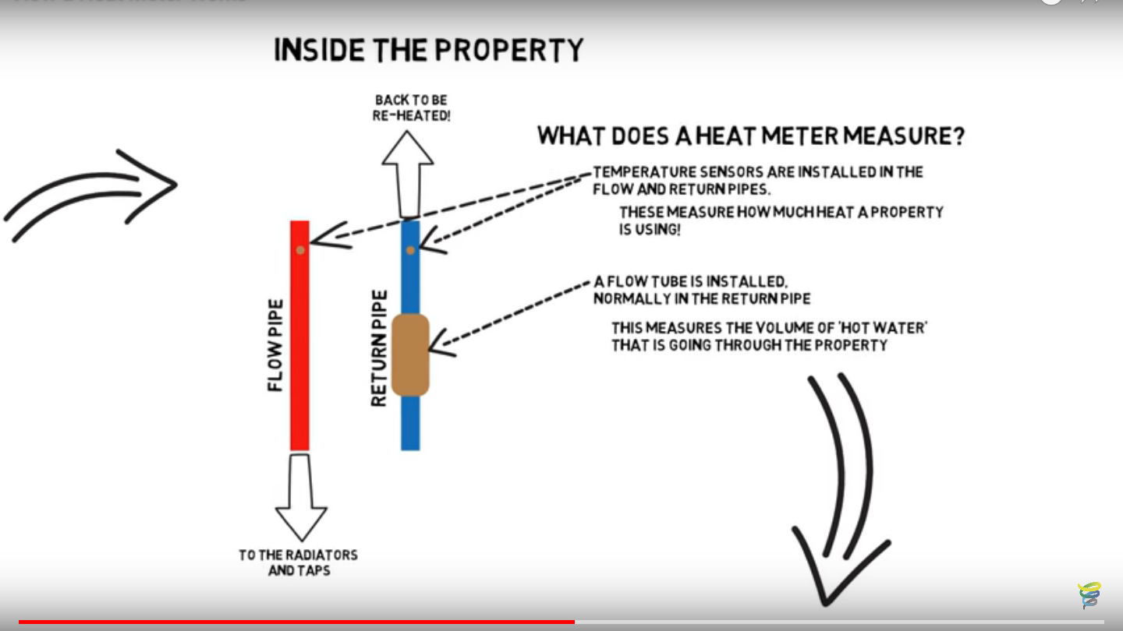
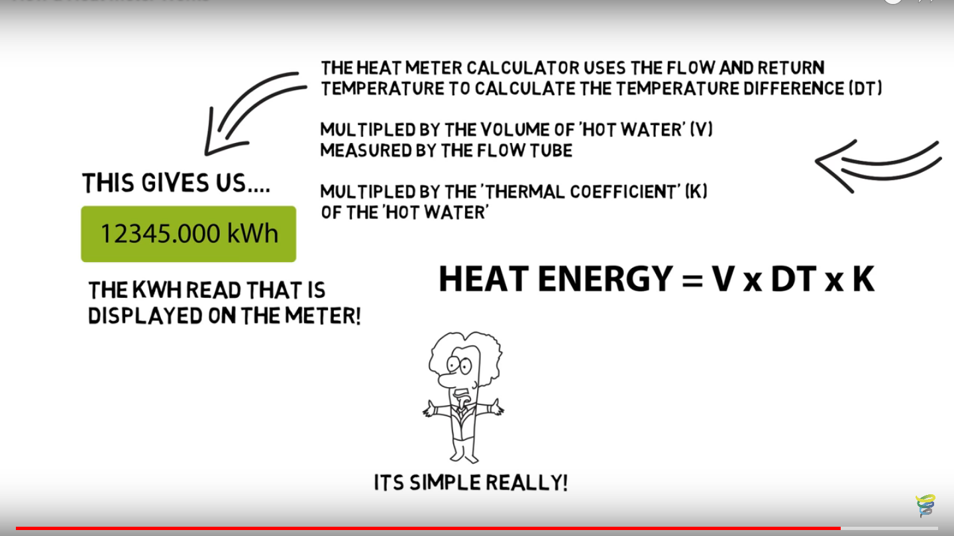
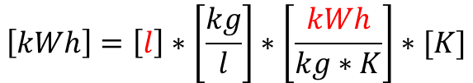
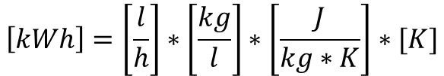
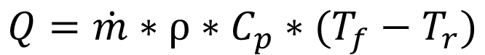
Heat Meters
https://youtu.be/LR0rQ5vK8do
$$Q=\dot{m}∗ρ∗C_{p}∗(T_{f}−T_{r})$$
$$\left[kWh\right]=\left[\frac{l}{h}\right]∗\left[\frac{kg}{l}\right]∗\left[\frac{J}{kg∗K}\right]∗[K]$$
$$\left[kWh\right]=\left[l\right]∗\left[\frac{kg}{l}\right]∗\left[\frac{kWh}{kg∗K}\right]∗[K]$$

Slide 71
Heat Meters
https://youtu.be/LR0rQ5vK8do

Slide 72
Heat Meters
Relevant Issue:
Rounding errors. Particularly with low water Flow
Meter stores integrated Energy:
Supply: ∫ (volumen * T_supp)
Return: ∫ (volumen * T_return)
Delivered energy is calculated as a substraction from these two variables
Needs to be corrected for fluids other than water: Cp & density
Measurement error << 5% (EN-1434–1:2015)

Slide 73
Other Fuels
No continous metering
Unless especifically installed on-site.
Purchase invoices & delivery notes.
i.e. 2017kg of biomass delivered on 2021/09/12
Uncertainties:
Heat capacity
Unaccounted storage of materials
i.e. 375kg were already there before the unloading,…
…423kg were not spent before the next unloading
…
Mainly for liquid & solid fuels

Slide 74
Meters (summary)
Electricity. Frequent data is available.
Natural Gas. Typically, bulk readings. i.e. monthly
Heat. Great progress towards frequent data.
Fuels. Bulk readings with large uncertainty

Slide 75
Exercise
Heat load analysis of one building
Questions:
Intial plot. Is there any visible trend or data group?
Can this be explained by daily patterns?
Can it be further explained by hourly patterns?
Does the sun have any influence?
Which is the relation of load to climate?

Slide 76
Exercise
Heat load analysis of one building
Questions:
Intial plot. Is there any visible trend or data group?

Slide 77
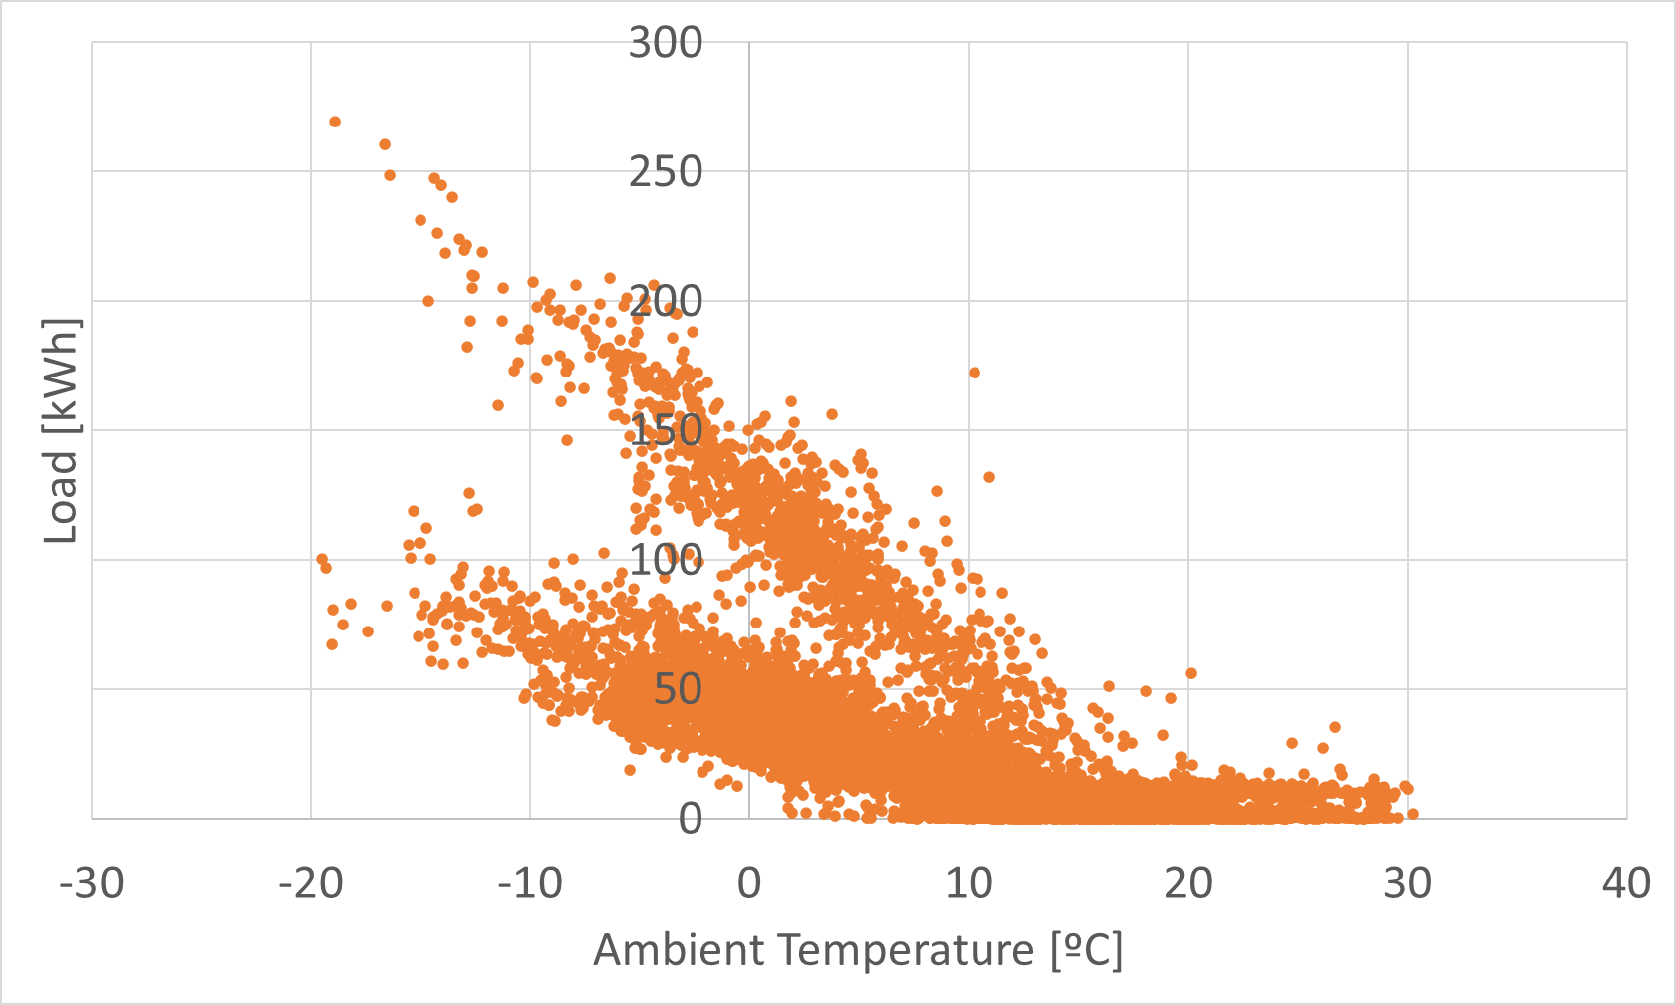

Slide 78
Exercise
Heat load analysis of one building
Questions:
Intial plot. Is there any visible trend or data group?
YES. Two main slopes + horizontal section
Can this be explained by daily patterns?

Slide 79
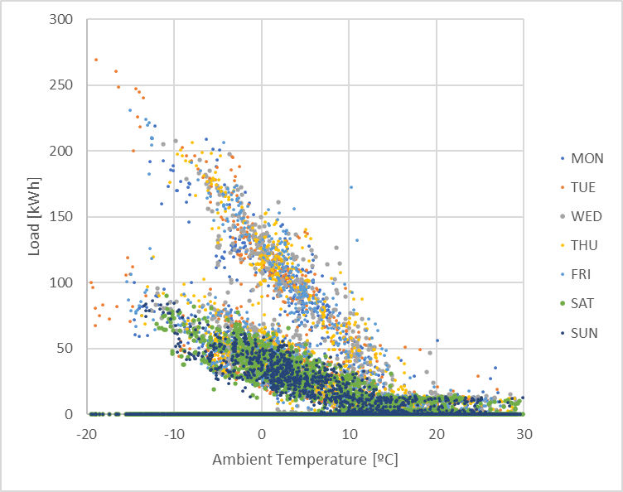
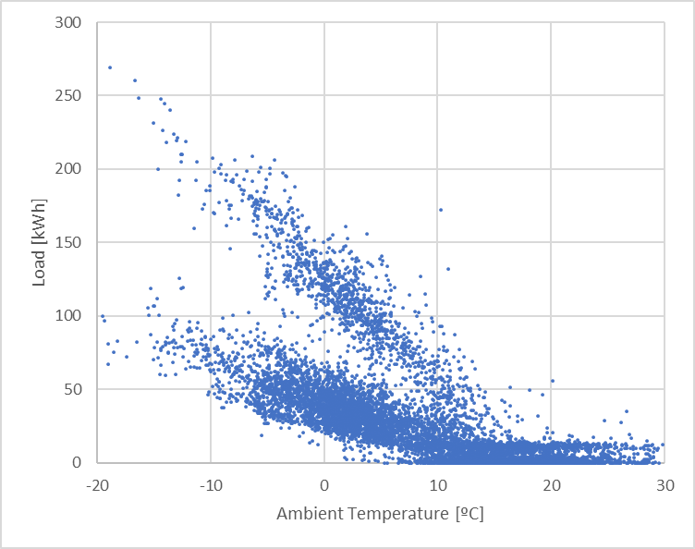

Slide 80
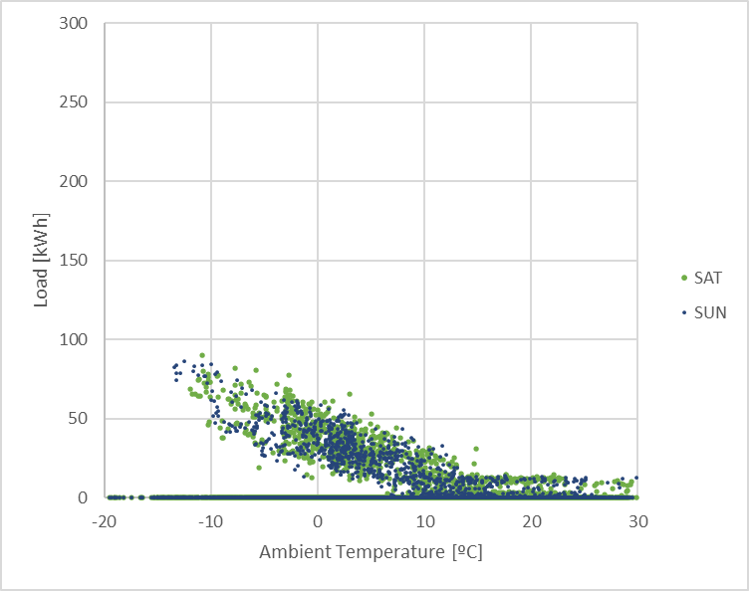
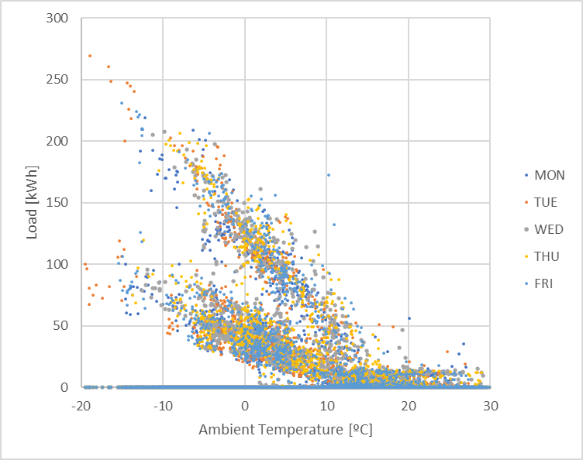
Saturday & Sunday
Monday - Friday

Slide 81
Exercise
Heat load analysis of one building
Questions:
Intial plot. Is there any visible trend or data group?
YES. Two main slopes + horizontal section
Can this be explained by daily patterns?
PARTIALLY. Weekends
Can it be further explained by hourly patterns?

Slide 82
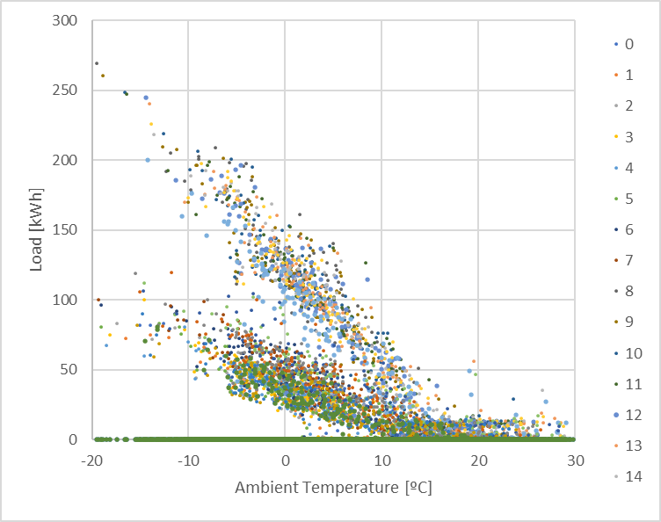
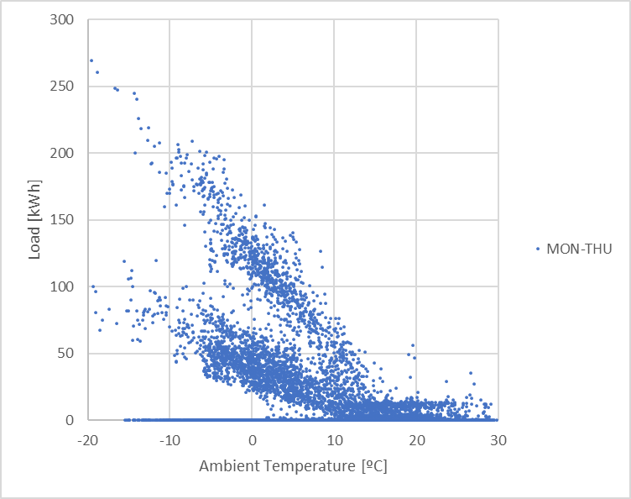
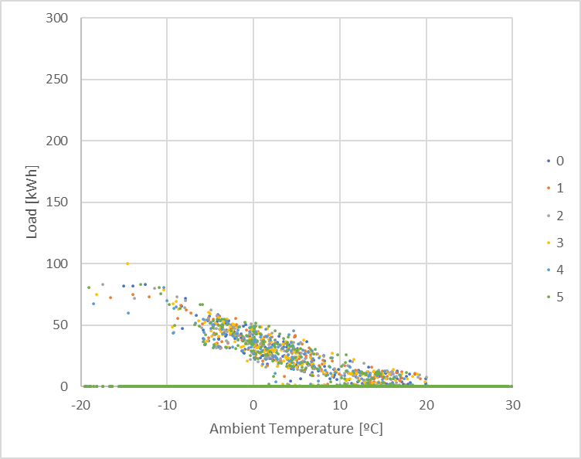
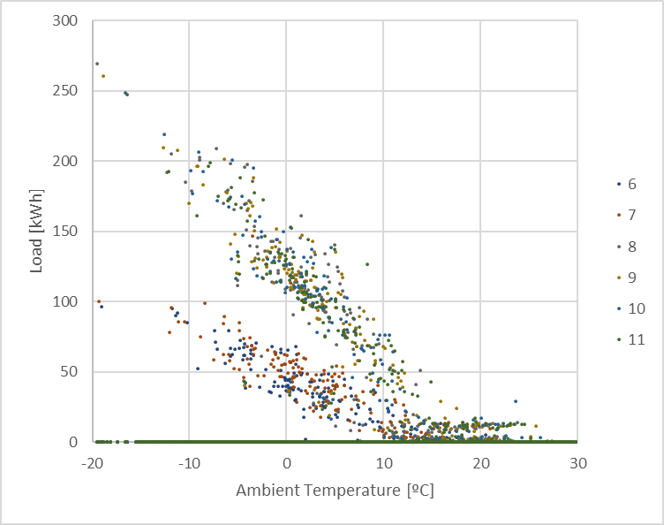
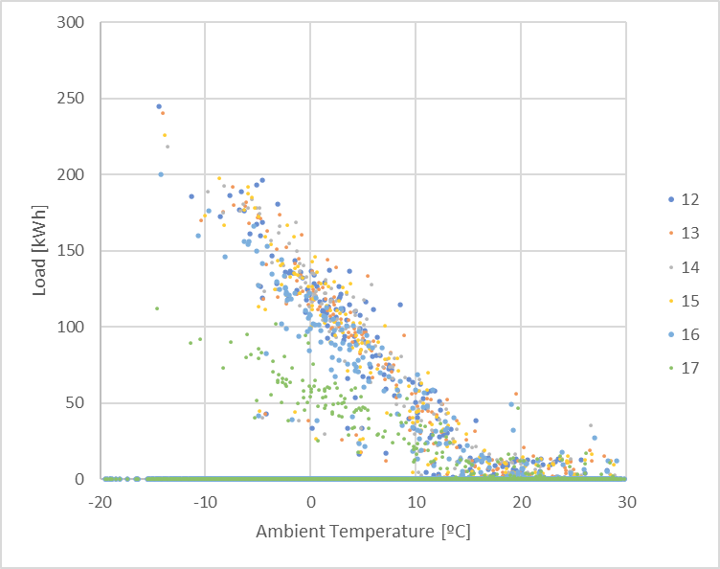
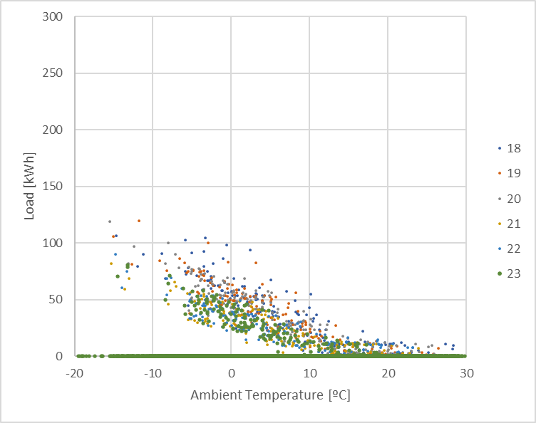
0h to 5h
6h to 11h
12h to 17h
18h to 23h

Slide 83
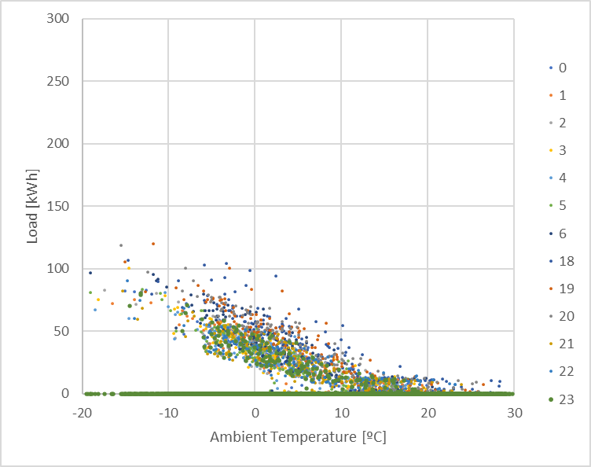
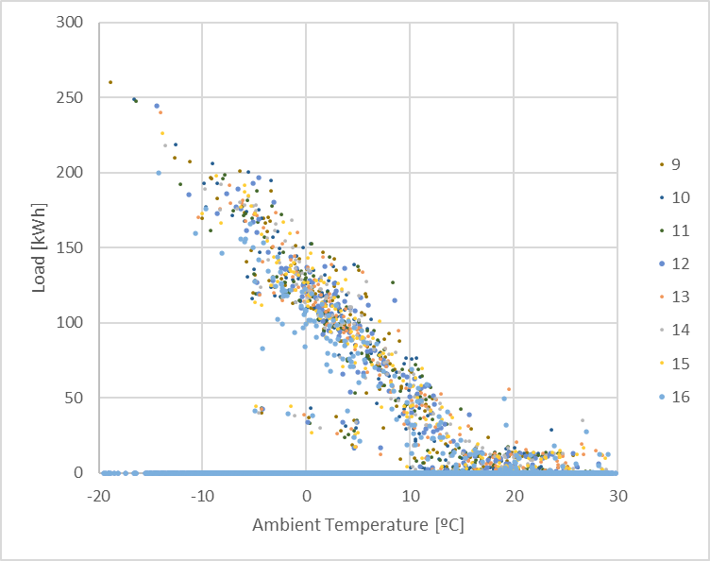
18h to 6h
9h to 16h
Transition:
7h
8h
17h

Slide 84
Exercise
Heat load analysis of one building
Questions:
Intial plot. Is there any visible trend or data group?
YES. Two main slopes + horizontal section
Can this be explained by daily patterns?
PARTIALLY. Weekends
Can it be further explained by hourly patterns?
YES. Office pattern
Does the sun have any influence?

Slide 85
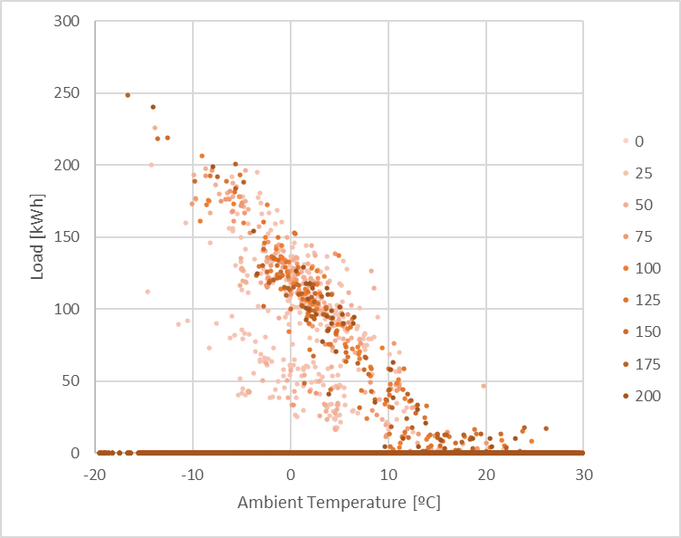
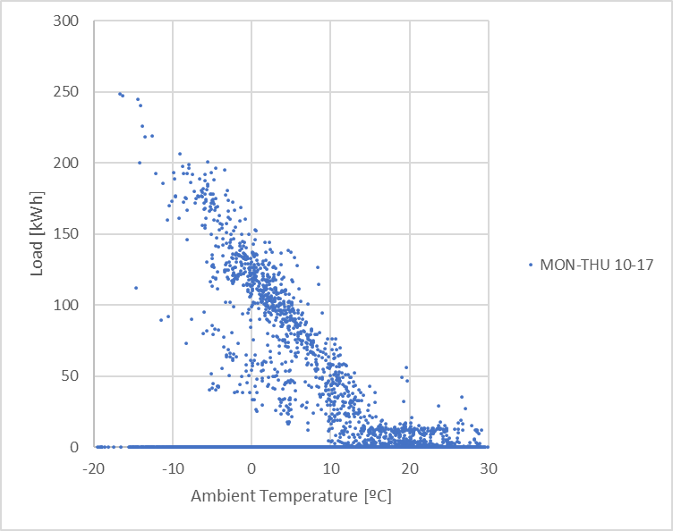
(Irradiation levels)

Slide 86
Exercise
Heat load analysis of one building
Questions:
Intial plot. Is there any visible trend or data group?
YES. Two main slopes + horizontal section
Can this be explained by daily patterns?
PARTIALLY. Weekends
Can it be further explained by hourly patterns?
YES. Office pattern
Does the sun have any influence?
NOT REALLY
Which is the relation of load to climate?

Slide 87
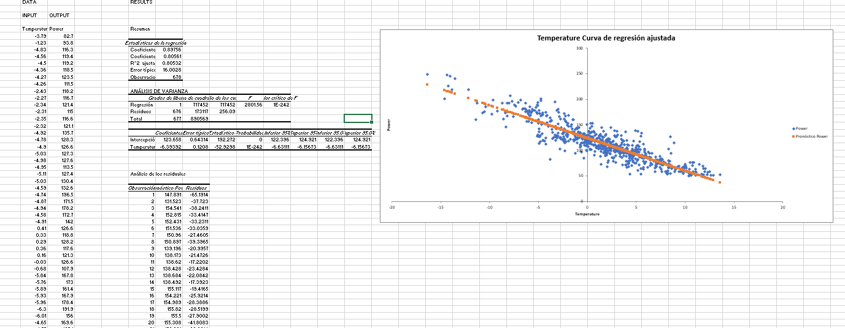
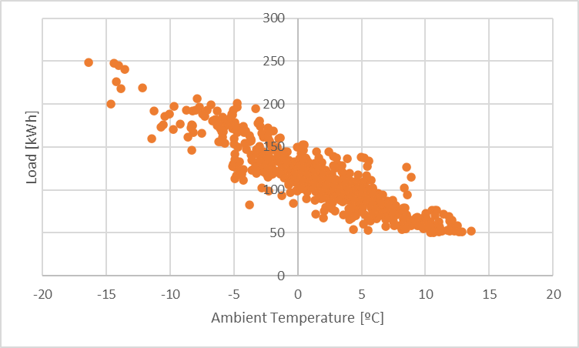
Highly filtered data:
Mon-Thu
10-17h
Ambient temperatura <15ºC
Load > 25kWh
Use of linear regression procedure in EXCEL

Slide 88
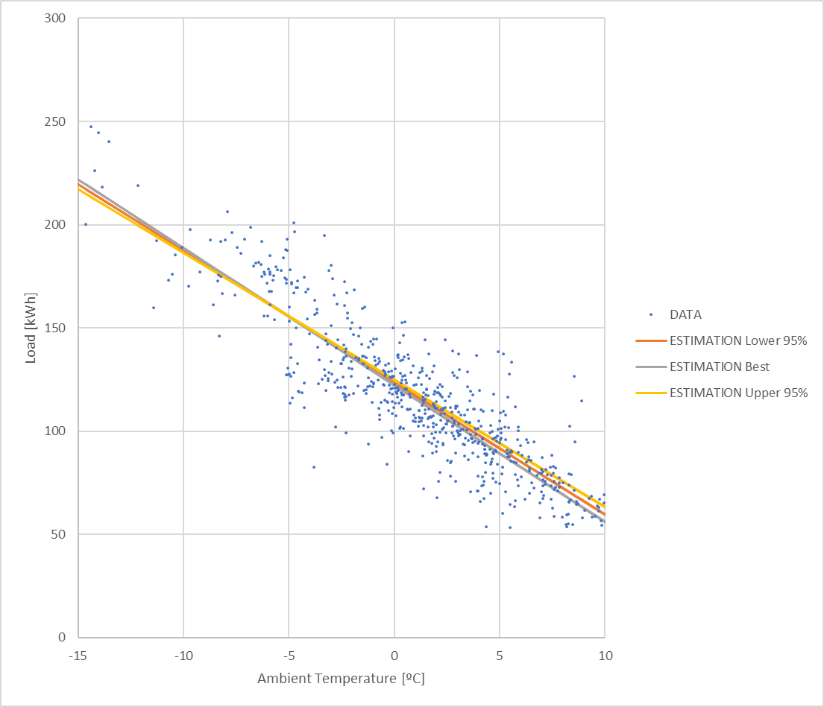
 | Value | Lower 95% | Upper 95%
Intercept | 123.66 | 122.40 | 124.92
Slope | -6.40 | -6.63 | -6.16

Slide 89
Exercise
Heat load analysis of one building
Questions:
…
Which is the relation of load to climate?
@0ºC ~123kW
Rise per ºC ~6kW

Slide 90


Acknowledgements
The data used in this exercise has been gathered within project RELaTED.
http://www.relatedproject.eu/
This project has received funding from the European Union’s Horizon 2020 research and innovation programme under grant agreement No 768567.

Slide 91
Price of energy carriers
Tariff structure
Variations along the year.
Electricity
Natural gas
Demand-response & Interruptibility

Slide 92
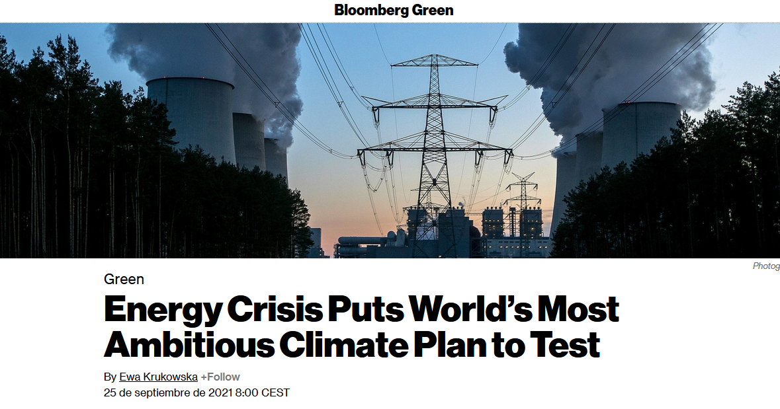
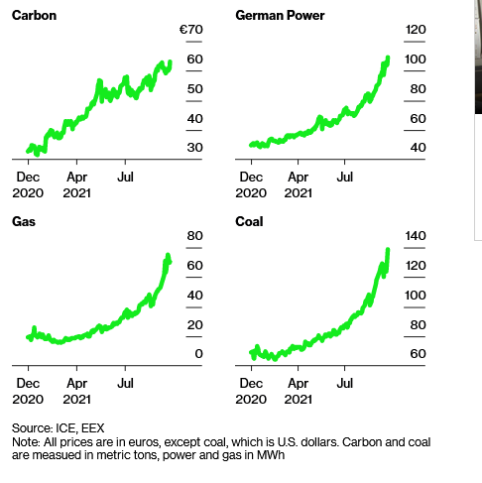
OUTDATED!!!
+100% +150%
X3 +100%
(May be even worse when the lecture is delivered)
https://www.bloomberg.com/news/articles/2021-09-25/energy-crisis-puts-world-s-most-ambitious-climate-plan-to-test

Slide 93


Definition: Utility Company / Utility
https://www.collinsdictionary.com/us/dictionary/english/utility-company

Slide 94
Tariff structure. Electricity
Focused at balancing the network
Cost of infrastructure
Cost of Energy production
Fixed + Variable cost structure
Fixed. Connection fees
Depends on installed/contracted power. (kW)
Variable. Consumption
Energy (kWh)
Cost
Consumption

Slide 95
Tariff structure. Electricity
Connection fees
Defined per contracted capacity (kW)
Cosummer has the “right” to consume this capacity at any time
If exceded, utilities can cut the delivery, or charge penalties
Typically can be defined independently for specific periods
e.g. Industry that operates at night can have a huge contracted capacity for those periods, and smaller capacity during peak hours.
This leads to “explicit” capacity definition at energy network level

Slide 96
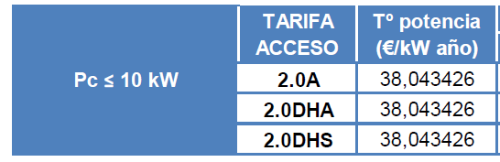
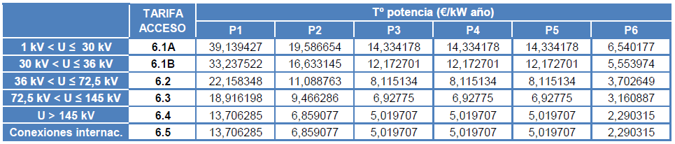
Tariff structure. Electricity
Spain: IET 107/2014
…

Slide 97

Tariff structure. Electricity

Slide 98

Tariff structure. Electricity
Energy
Defined by consumed Energy (kWh)
Diferent Price for every hour
Depends on wholesale cost of electricity
Fixed based on production technologies for each hour and their costs at National/Regional level
Electricity, Energy, Spot value in Spain, 2020
€/MWh
time

Slide 99
Tariff structure. Electricity
Electricity, Energy, Spot price in Spain, 1st January 2020
+ 50 %
- 33%

Slide 100

Tariff structure. Electricity
One Day Ahead prices for SWEDEN. (captured on 2021/03/17)
https://www.nordpoolgroup.com/Market-data1/Dayahead/Area-Prices/ALL1/Hourly/?view=chart

Slide 101
Tariff structure. Natural Gas
Same Fixed + Variable cost structure as for Electricity
No intra-daily price variations
Cost comparison
(dwellings) | Fixed fee [€/month] | Variable fee [€/kWh]
Electricity | ~15€ | 0,06 - 0,13
Natural Gas | 8 | 0,04

Slide 102

https://comparador.cnmc.gob.es/

Slide 103

Variations
Natural Gas
+300 %
- 60 %
Year

Slide 104

Variations
Electricity spot Price. Daily averages
Spain
France
Other Western EU
https://www.esios.ree.es/

Slide 105
Demand-response & Interruptibility
Demand-response
Avoid excessive costs: Prevent most expensive heat production systems
Ensure that loads match the one-day ahead load forecast
Distribute energy consumption throughout less-expensive periods of the day
Economic suggestion + self- optimisation
Interruptibility
Keep system stability: Electric suppliers need to keep the balance of the network: 50Hz (60Hz) at all times
Compensate consumers to interrupt (fully or partially) energy supply
Voluntary. Once signed for it, compulsory to interrupt upon short notice (i.e. 10 minutes)
(Electricity)

Slide 106
Price of energy carriers (Summary)
Energy is a valuable resource
Complex & highly regulated environment
Energy is traded in international markets
There are relevant variations in the price of Energy carriers in the médium & long term
Electricity can not be stored in sufficient quantities
Electricity prices evolve on the short term (i.e. hours)

Slide 107
Variability
Users
Non-explicit schedules
Confort
Failures
Pandemics

Slide 108

Climate
???

Slide 109

Users
Users behave slightly differently every day
Weather-normalized heat load patterns in a building. Lumbreras eta Al. (Unpublished)

Slide 110


Users
“A London woman's love life and career both hinge, unknown to her, on whether or not she catches a train. We see it both ways, in parallel.”
https://www.imdb.com/title/tt0120148/
The Energy Load of a building varies depending on:
If you take the bus at 8:30 or you sleep 5’ more
If it’s raining and you leave jogging for tomorrow
You invite Friends to dinner
You are visiting a friend in Australia
You move to Belgium next semester
…

Slide 111
Non-explicit schedules
Explicit
Typical day
Open to the public: 10-14h
Employees
Building open: 8-17h
Working time: 8h. Some with reduced time (various reasons: Children, education,…)
Interruptions: 2-3 (Coffee, lunch, short walk,…)
Not same to all people
Some work from home 2-3 days per week
Variations
20-40% of personnel gets out of the office for some reason (meetings, seminars,…)
2-5% of people are sick at home

Slide 112
Confort
Setpoints vary depending on user preferences
Reference for heating: 20-22ºC (country dependent)
Sleeping reference : ~19ºC
Buildings have some thermal inertia & need some time to adapt
2-3 ºC of variation
Temperature reduction: 2-5h with ~no load
Temperature rise: 1-3h with increased load

Slide 113




Confort
Users may prefer other temperature levels
24ºC
0ºC
10ºC
15ºC

Slide 114
Failures & technical limitations
Systems do not always work as expected
District Heating systems
Available energy may be limited by supply temperature & flow conditions
Electric systems
Limitations to comply with contracted capacity
Simultaneous use for heating & other applications
Liquid & Solid Fuels
System may run out of fuel
All
Limited to rated capacity of equipment (boiler, heat pump, substation,…)
System stoped for repairs & maintenance

Slide 115

Pandemics
Our weird behavior during the pandemic is messing with AI models
Machine-learning models trained on normal behavior are showing cracks —forcing humans to step in to set them straight.

Slide 116
Variability (Summary)
Real life is more complex than rated setpoints & standard user profiles

Slide 117
Data Quality
Voids/Gaps & how to fill them
Outliers

Slide 118
Voids/Gaps & how to fill them
Modern data gathering systems
Get frequent measurements
Daily (non critical applications)
Hourly (most heating & cooling systems)
15-minutely (e.g. electricity sector)
<1-minutely (control applications)
…
Transfer data to databases every short term
~Continous (control applications)
<1-daily (any business-related system)
>1-daily (applications to residential sectors)
…

Slide 119
Voids/Gaps & how to fill them
Systems fail (sometimes)
Blackouts
Batteries and UPS systems
Failure in data/telephone connections
GSM/3G/… connections are increasingly common for small applications
Systems are not perfect
Internal memory gets full
Systems reboot
…
Systems are not sufficiently supervised
Failures and errors are not detected & corrected promptly

Slide 120
Voids/Gaps & how to fill them
So there is data loss
Well designed/implemented/maintained systems <10%
Others >10%

Slide 121

Voids/Gaps & how to fill them
Example 1
Data from heat meters.
~Good quality
(1 year = 8760h)
8760 – 8410 = 350 (~4-5%)
If a day starts at 0h, it should end at 23h

Slide 122

Voids/Gaps & how to fill them
Example 2
Data from cooling plant
~ bad quality
(some systems interpolate when there is missing data)

Slide 123


Voids/Gaps & how to fill them
Example 2
Data from cooling plant
~ bad quality
Normal Behavior
Data loss
Normal Behavior (again)
Last real data point
First real data point
$$Y=Y_{1}+\left(X−X_{1}\right)\frac{\left(Y_{2}−Y_{1}\right)}{\left(X_{2}−X_{1}\right)}$$

Slide 124

Voids/Gaps & how to fill them
Data from Tartu.
January, 31 days. No data loss (in original dataset)

Slide 125
Voids/Gaps & how to fill them
Are all days similar?

Slide 126
Voids/Gaps & how to fill them
How many profiles?

Slide 127




Voids/Gaps & how to fill them
How many profiles?

Slide 128

Voids/Gaps & how to fill them
How to fill voids. OPTION 1. Linear interpolation

Slide 129

Voids/Gaps & how to fill them
How to fill voids. OPTION 1. Linear interpolation

Slide 130

Voids/Gaps & how to fill them
How to fill voids. OPTION 1. Linear interpolation

Slide 131
Voids/Gaps & how to fill them
How to fill voids. OPTION 1. Linear interpolation
OK for ~stable areas
OK for ~homogeneous slopes
TO BE IMPROVED for other areas

Slide 132

Voids/Gaps & how to fill them
How to fill voids. OPTION 2. Replacement by typical day

Slide 133
Voids/Gaps & how to fill them
How to fill voids. OPTION 3. Calculation of diferential profile

Slide 134

Voids/Gaps & how to fill them

Slide 135

Voids/Gaps & how to fill them

Slide 136


Voids/Gaps & how to fill them
Other Options
Johra, H., Leiria, D., Heiselberg, P., Marszal-Pomianowska, A., Tvedebrink, T., Treatment and analysis of smart energy meter data from a cluster of buildings connected to district heating: A Danish case
(2020) E3S Web of Conferences, 172, art. no. 12004, DOI: 10.1051/e3sconf/202017212004

Slide 137
Outliers
There is typically a certain amount data which is not consistent
Measurement errors
Abnormal behavior
This data should be removed
Data removal should be consistent
Remove one data point?
Remove full day?
Remove full week?
Remove preceding and succeeding interval?

Slide 138
Outliers
Guidance
Remove a small ammount of data
Typically ~<2,5-5%
Remove data within its context
If analysis is performed by month:
Subset “January”, then identify outliers
(extreme data means differnt things in January or in June)
ASHRAE 14. Table 14-2
Maximum 25% of data, should be properly explained
SEEMS TO BE TOO LOOSE.

Slide 139
Outliers
7,5 to 12,5 ºC

Slide 140

Outliers
Very few points
(Data below 25kWh is discarded)

Slide 141


Outliers
Discarding criteria:
Standard Deviation: Data which is farther tan 2*Sd from the mean
Inter-Quartile: Data which is farther tan IQR from the mean. IQR=Q3-Q1
Standard deviation IQR

Slide 142
Outliers
Remove
Standard deviation IQR
Which criteria is best?

Slide 143
Data Quality (Summary)
There is a lot of data in modern systems
Some times:
Systems fail (hopefully <10%)
Data is incorrect (outliers)
Faulty data should be filtered-out
Datasets need to be repaired
Repair techniques need to be fit for purpose
Interpolation
Typical values
Typical evolution

Slide 144
Energy management platforms
Evolution
Handling large datasets
Modern user experience
Commercial tools
Applications
Benchmarking
M&V processes
Alerts
Data pipeline. Hardware/Software/Cloud/User

Slide 145

Evolution. Handling large datasets
https://www.flickr.com/photos/ejk/808461304 (CC BY-SA 2.0)

Slide 146

Evolution. Handling large datasets
https://www.flickr.com/photos/151112035@N05/31610696003 (CC BY-NC-SA 2.0)

Slide 147

Evolution. Handling large datasets
https://commons.wikimedia.org/wiki/File:U-SQL.gif (CC BY-SA 4.0)

Slide 148

Evolution. Handling large datasets

Slide 149

Evolution. Modern user experience
https://www.smarkia.com/es

Slide 150
Commercial tools
(some)
https://www.smarkia.com/
https://www.dexma.com/
https://www.ekiom.com/en/
http://genio.pro/
https://www.wattics.com/
https://www.energis.cloud/en/
https://linkener.com/
https://seinon.org/
…

Slide 151
Commercial tools
In most cases, for specific uses
Retail: multi-point, low complexity
Malls: high complexity, HVAC focused
PV plants
EV charging spots: Multi-point, invoicing
Industry: Highly customizable
Condos: Multi-customer
Various purposes
Supervision
Alerts
Benchmarking
M&V
Invoicing
Remote management

Slide 152
Commercial tools
According to public information, all vendors deliver same quality & functionality
This is almost false
There is a need to clearly define customer needs and map them to the management platforms to make a good choice
Connectivity to third party (on-site) hardware is easy
This is quite true (& improving)

Slide 153

















Commercial tools

Slide 154


Applications. Insights
https://www.smarkia.com/en

Slide 155

Applications. Benchmarking
https://www.azavea.com/projects/energy-benchmarking/

Slide 156

Applications. M&V processes
Samir Touzani, Jessica Granderson, David Jump, Derrick Rebello, 2019, Evaluation of methods to assess the uncertainty in estimated energy savings, Energy and Buildings 193, https://doi.org/10.1016/j.enbuild.2019.03.041

Slide 157

Applications. Submetering & allocation

Slide 158


Applications. Alerts

Slide 159

Applications. Reports

Slide 160
Data pipeline. Hardware/Software/Cloud/User
Item | Scale | Type | Operation | Data storage
Sensors & actuators | Field activity | Physical | Continous ~Real time | No
Local system | Building / Facility level | Physical | Continous ~ Near Real time | ~< 1week
Cloud | Multi-building / Facility | Virtual | Supervision* ~>1day | No limit

Slide 161
Energy management platforms (Summary)
Gather information from many buildings
Simplify the user experience
No need for IT & communication knowledge
No need for investement in hardware & connectivity
Data is properly managed & backed up
Accessible through web-app
No need for programming skills
Perform most of the low-level activities
Can focus on delivering relevant outcomes
Caution
Verify thay you understand what the system is doing
Verify that data can be accessed & exported
Advanced applications
Migration to new vendor

Slide 162
Analysis methods
Energy Signature & Regression
Decision Trees Gradient Boosting & Random Forrest
Neural Networks
Clustering

Slide 163
Energy Signature & Regression
PRISM
Ashrae Changepoint
Multivariable
Method Extension

Slide 164


PRISM
1973 Oil Crisis
Initial policies for Energy conservation
First standardized methods ~1970/80
PRISM
PRInceton Scorekeeping Method
https://www.businessinsider.com/gas-signs-1970s-2011-8#-18

Slide 165

PRISM
Margaret F. Fels, PRISM: An introduction, Energy and Buildings, 1986, https://doi.org/10.1016/0378-7788(86)90003-4
FIGURE 1a & 4a
Margaret F. Fels, PRISM: An introduction, Energy and Buildings, 1986, https://doi.org/10.1016/0378-7788(86)90003-4

Slide 166
PRISM
Margaret F. Fels, PRISM: An introduction, Energy and Buildings, 1986, https://doi.org/10.1016/0378-7788(86)90003-4
FIGURE 4b & TABLE 1
Margaret F. Fels, PRISM: An introduction, Energy and Buildings, 1986, https://doi.org/10.1016/0378-7788(86)90003-4

Slide 167
PRISM
Margaret F. Fels, PRISM: An introduction, Energy and Buildings, 1986, https://doi.org/10.1016/0378-7788(86)90003-4
EQUATIONS 3 & 4
Margaret F. Fels, PRISM: An introduction, Energy and Buildings, 1986, https://doi.org/10.1016/0378-7788(86)90003-4

Slide 168
PRISM
HDD reference temperature 20ºC
Baseload 1.12kWh/day
Thermal sensitivity 400Wh/day
Climate-related load
107 GJ/year
(over actual climate)
142,5 GJ/year
(over reference climate)
Margaret F. Fels, PRISM: An introduction, Energy and Buildings, 1986, https://doi.org/10.1016/0378-7788(86)90003-4
TABLE 1
Margaret F. Fels, PRISM: An introduction, Energy and Buildings, 1986, https://doi.org/10.1016/0378-7788(86)90003-4

Slide 169
PRISM
Robust method
Based on few data
Filters-out transitory effects
Starting point for more modern methods
Margaret F. Fels, PRISM: An introduction, Energy and Buildings, 1986, https://doi.org/10.1016/0378-7788(86)90003-4

Slide 170

Ashrae Changepoint
Margaret F. Fels, PRISM: An introduction, Energy and Buildings, 1986, https://doi.org/10.1016/0378-7788(86)90003-4
FIGURE 4a
Changepoint
HDD
TEMPERATURE
Kissock, J.K., Jeff S Haberl, and David E. Claridge. 2002. “Development of a Toolkit for Calculating Linear, Change-Point Linear, and Multiple-Linear Inverse Building Energy Analysis Models.”

Slide 171
Ashrae Changepoint
Replaces the Degree-Day approach for a “changepoint” temperatura approach
Generalizes PRIMS for a variety of loadds
Heating
Cooling
Heating & Cooling
Multi-sloped loads

Slide 172

Ashrae Changepoint
More parameters are calculated (p)
More observations are needed (i)
i > 20 * p
The validation process is more complex
Applicability over data with greater resolution
Phenomena not associated to outdoor ambient temperatura is visible
Mitchell T. Paulus, David E. Claridge, Charles Culp, Algorithm for automating the selection of a temperature dependent change point model, Energy and Buildings, https://doi.org/10.1016/j.enbuild.2014.11.033

Slide 173
Multivariable
Additional variables can be considered
Solar radiation
Calendar
Ocupancy level
~Electric load?
Temperature/load in previous days
…

Slide 174

Multivariable
Additional variables can be considered
Solar radiation

Slide 175
Multivariable
Additional variables can be considered
Solar radiation
Calendar
Sicheng Zhan, Zhaoru Liu, Adrian Chong, Da Yan, Building categorization revisited: A clustering-based approach to using smart meter data for building energy benchmarking, Applied Energy, Volume 269, 2020, https://doi.org/10.1016/j.apenergy.2020.114920
FIGURE 8
Sicheng Zhan, Zhaoru Liu, Adrian Chong, Da Yan, Building categorization revisited: A clustering-based approach to using smart meter data for building energy benchmarking, Applied Energy, https://doi.org/10.1016/j.apenergy.2020.114920

Slide 176
Multivariable
Additional variables can be considered
Solar radiation
Calendar
Ocupancy level
~Electric load?
Xin Liang, Tianzhen Hong, Geoffrey Qiping Shen, Improving the accuracy of energy baseline models for commercial buildings with occupancy data, Applied Energy, https://doi.org/10.1016/j.apenergy.2016.06.141
FIGURE 7
Xin Liang, Tianzhen Hong, Geoffrey Qiping Shen, Improving the accuracy of energy baseline models for commercial buildings with occupancy data, Applied Energy, https://doi.org/10.1016/j.apenergy.2016.06.141

Slide 177
Method Extension
Larger number of explainatory variables
Indicators of building usage
Occupamcy of parking lot, canteen,…
Eater consumption (cold and/or hot)
Electric consumption (Computers/plug loads)
Status of internet connection
Meeting room booking system
Calendar, vacations,…
…

Slide 178
Method Extension
Transitories & thermal inertia
Climate
Average climate data T-24h..T
(Was yesterday colder than today?)
Building usage (days after holidays?)
Average heat load T-24h..T
(Was the boiler active yesterday?)

Slide 179
Method Extension
(Indirect)
Data segmentation for typical periods & calibration for each one
Season Systems turned off in summer
Weekday Weekly patterns & thermal inertia, holidays
Hour Daily patterns, (i.e. lunch)
Hour of the week
(other specific patterns for specific buildings)

Slide 180
Decision Trees, Gradient Boosting & Random Forrest
Decision Trees
Gradient Boosting
Random Forrest

Slide 181

Decision Trees
Data is subsetted
Then a value/model is developed for each area
Three different representations of a classification tree of kyphosis data, Stephen Milborrow, https://en.wikipedia.org/wiki/Decision_tree_learning#/media/File:Cart_tree_kyphosis.png CC BY-SA 4.0

Slide 182


Decision Tree
Mikel Lumbreras, Roberto Garay-Martinez, Beñat Arregi, Koldobika Martin-Escudero, Gonzalo Diarce, Margus Raud, Indrek Hagu, Data driven model for heat load prediction in buildings connected to District Heating by using smart heat meters, Energy, 2022, https://doi.org/10.1016/j.energy.2021.122318

Slide 183



Decision Tree
Mikel Lumbreras, Roberto Garay-Martinez, Beñat Arregi, Koldobika Martin-Escudero, Gonzalo Diarce, Margus Raud, Indrek Hagu, Data driven model for heat load prediction in buildings connected to District Heating by using smart heat meters, Energy, 2022, https://doi.org/10.1016/j.energy.2021.122318

Slide 184
Gradient Boosting
Real Relationship Y~f(X) (unknown)
All models are imperfect
Y_e1~g(X) !=f(X)
There is an error (gradient)
grad_e1 = Y – g(X)

Slide 185
Gradient Boosting
Differential model
grad_e1 ~ h(X) != Y – g(X)
Aggregation of both models
Y_e2 ~ g(X) + h(X) !=f(X)
Y – g(X)-h(X) < Y-g(X)
iterate…g(X), h(X), I(X), J(X),…

Slide 186
Gradient Boosting (note)
Differential model
grad_e1 ~ h(X) != Y – g(X)
Functions do not need to be continous, derivable,…relaciones contínuas, derivables,…
i.e.: h(X) = 35 (X>10)
h(X) = 40 (X<=0)

Slide 187

Gradient Boosting
https://en.wikipedia.org/wiki/Gradient_boosting

Slide 188

Gradient Boosting
https://www.geeksforgeeks.org/ml-gradient-boosting/

Slide 189

Random Forrest
Several inperfect models. Each of these:
Calibrated aganist a different subset of observations
Using only a subset of available explainatory variables
Result is averaged
Diagram of a random decision forest
Venkata Jagannath - https://community.tibco.com/wiki/random-forest-template-tibco-spotfirer-wiki-page
CC BY-SA 4.0

Slide 190

Neural Networks
Several (simple) functions are chained to create a complexnetwork
Temperature
Solar Radiation
Month
Hour
…
Heat load
…
An example artificial neural network with a hidden layer
https://en.wikipedia.org/wiki/Artificial_neural_network#/media/File:Artificial_neural_network.svg
CC BY-SA 3.0

Slide 191

Neural Networks
Typical functions
https://en.wikipedia.org/wiki/Activation_function

Slide 192
Review of analysis methods
What is the purpose of the analysis?
Short term load forecasting
Unbiased projection of models in the long term
Physical meaning
Models for extrapolation to other operational conditions
NOTE: All this may not be achievable with the same model

Slide 193
Review of analysis methods
Short term load forecasting
Large input datasets.
Many signals: Climate, use, internal conditions, heat load
Historical values: ~6h-7x24=144h
Complex models
Neural networks??
Potential risk for overfitting & validity limited to a short term

Slide 194
Review of analysis methods
Unbiased projection of models in the long term
Main relationship with climate
Lenear / Squared models with 2-4 main variables
Accurate models over aggregated periods (~daily, weekly,…) but highly unaccurate in specific observations (~hourly,…)
Stable in the long term (~years?)
Options
Linear Regresion
Support Vector Regression
Gradient boosting
Decission Trees (?)

Slide 195
Review of analysis methods
Physical significance
Regresion
Potentially with some segmentation

Slide 196
Review of analysis methods
Extrapolation to other operational conditions
AVOID models with hidden criteria
Decission Trees
Neuronal Networks
Alternatives
Linear Regresion
Support Vector Regression
Gradient boosting*

Slide 197
Wrap-up & Bonus material
Energy assessment
Increasingly complex with new data streams
Increasingly powerful with new data streams
Needs to be directed to particular applications
Highly ingfluenced by meter resoluation & data quality
Energy Costs
Very relevant to consummers
Influenced by user profiles & cost profiles
May need to be monitored under performance contract environments
Modern data platforms
Facilitate the delivery of assessments
There is still a need for relevant knowledge in the field of Energy modelling

Slide 198
Bonus materials
Github repository: https://github.com/robgaray/SMACCS_Building_Heat_Load_Analysis.git
These slides
Data
Assessment (Exercise on Day 2)
(some) relevant researchers in this field
Granderson, Jessica, https://www.scopus.com/authid/detail.uri?authorId=14630354400
Chong, Adrian, https://www.scopus.com/authid/detail.uri?authorId=57189900965
Hong, Tianzhen, https://www.scopus.com/authid/detail.uri?authorId=7202830430
Mor, Gerard, https://www.scopus.com/authid/detail.uri?authorId=56443716500
Bacher, Peder, https://www.scopus.com/authid/detail.uri?authorId=27667564700

Slide 199
Bonus materials
Self work
(all works) https://orcid.org/0000-0003-2331-6561
Data driven model for heat load prediction in buildings connected to District Heating by using smart heat meters, Energy, 2022, https://doi.org/10.1016/j.energy.2021.122318
Unsupervised Clustering for Pattern Recognition of Heating Energy Demand in Buildings Connected to District-Heating Network, https://doi.org/10.5281/zenodo.5583260
Energy meters in District-Heating Substations for Heat Consumption Characterization and Prediction Using Machine-Learning Techniques, https://doi.org/10.1088/1755-1315/588/3/032007
Data driven process for the energy assessment of building envelope retrofits, https://doi.org/10.1051/e3sconf/202017225001
Regression analysis of the energy consumption of tertiary buildings, https://doi.org/10.1016/j.egypro.2017.07.290

Slide 200
Acknowledgements
A relevant share of the data presented in this lecture has been gathered within project RELaTED.
http://www.relatedproject.eu/
This project has received funding from the European Union’s Horizon 2020 research and innovation programme under grant agreement No 768567.

